Slide 1
Table topics game 2

Slide 2
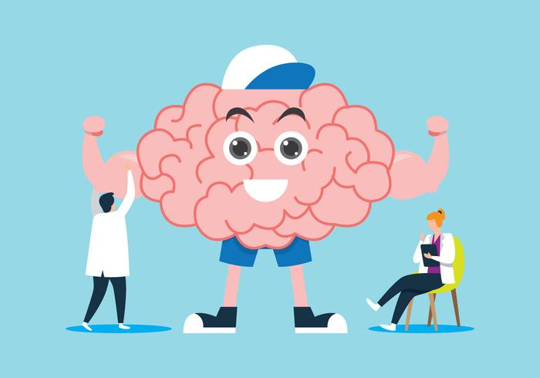
If you lived to be one hundred, would you rather have a sharp mind or a fit body?

Slide 3
What one fear would you like to conquer?

Slide 4
What household disaster happened to you?

Slide 5
Would you rather meet your great great grandparents or your great great grandchildren?

Slide 6
What remains undone that you’ve wanted to get done for years?

Slide 7
How many different places have you lived?

Slide 8
If you could donate one million dollars to charity, which would you choose?

Slide 9
What’s the scariest movie of all time?

Slide 10
What's your favorite quotation?

Slide 11
Which of your ancestors would you most like to meet?

Slide 12
Would you like to be proudest of your accomplishments or your character?

Slide 13
What posters did you have in your room when you were young?

Slide 14
Who is the most optimistic person you know?

Slide 15
What’s the secret to having a good marriage?

Slide 16
What’s the worst job you ever had?

Slide 17
Would you rather live by the beach or in the mountains?

Slide 18
If you decided to go on a spiritual journal, where would you go and what would you do?

Slide 19
Is it more essential to develop beliefs or gain knowledge?

Slide 20
Is justice or forgiveness more important?

Slide 21
Which piece of land would you preserve forever?

Slide 22
Who would you like to trade places with for one month?

Slide 23
What's the most fun party you ever attended?

Slide 24
Which language would you like to speak fluently?

Slide 25
If you owned a boat what name would you choose for it?

Slide 26
What’s your favorite song to play in the car?

Slide 27
How you define success?

Slide 28
Is it more important to be book-smart or street-smart?

Slide 29
What would you miss most about your home if you moved?

Slide 30
Which celebrity would you most like to see in person?

Slide 31
What was your most memorable meal ever?

Slide 32
What’s the strangest thing you’ve ever eaten?

