Slide 1
CEIT 708 Technology Enhanced Learning
Prof.Dr. Kürşat Çağıltay
kursat@metu.edu.tr

Slide 2
Project Based
Studio Approach for Design and Development
Applied (less reading, hands-on)
Team work

Slide 3
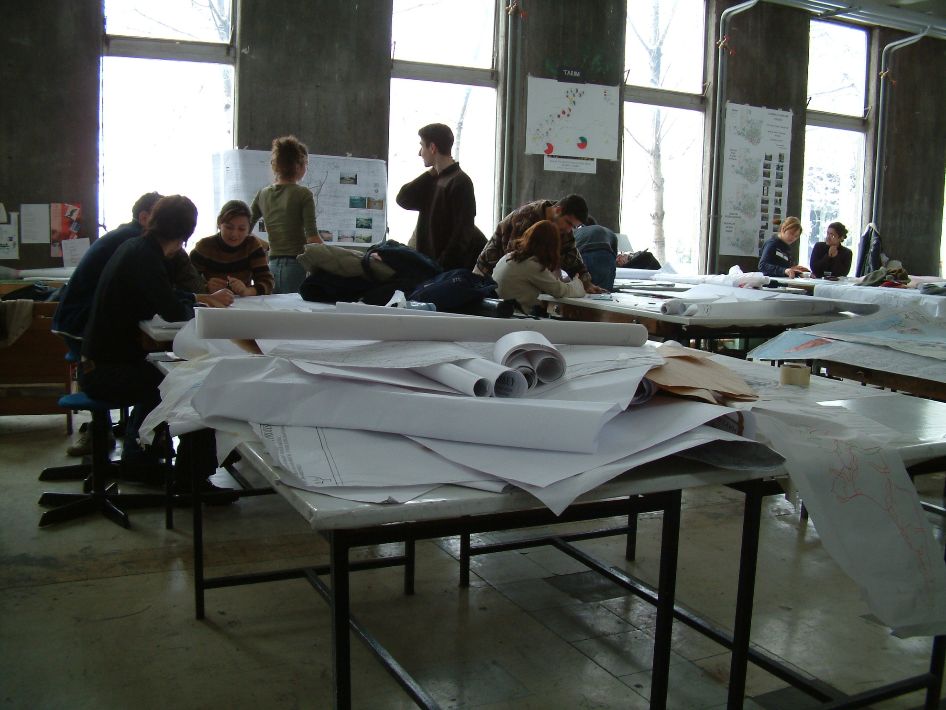

Slide 4
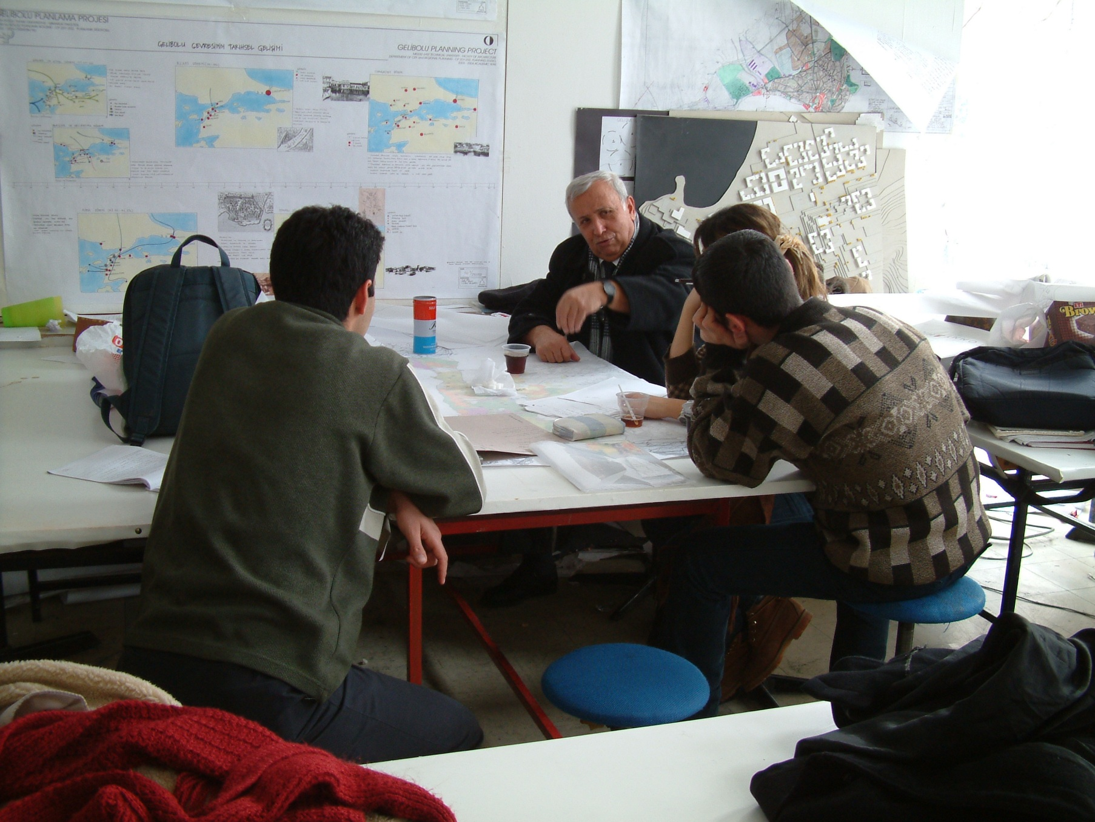

Slide 5
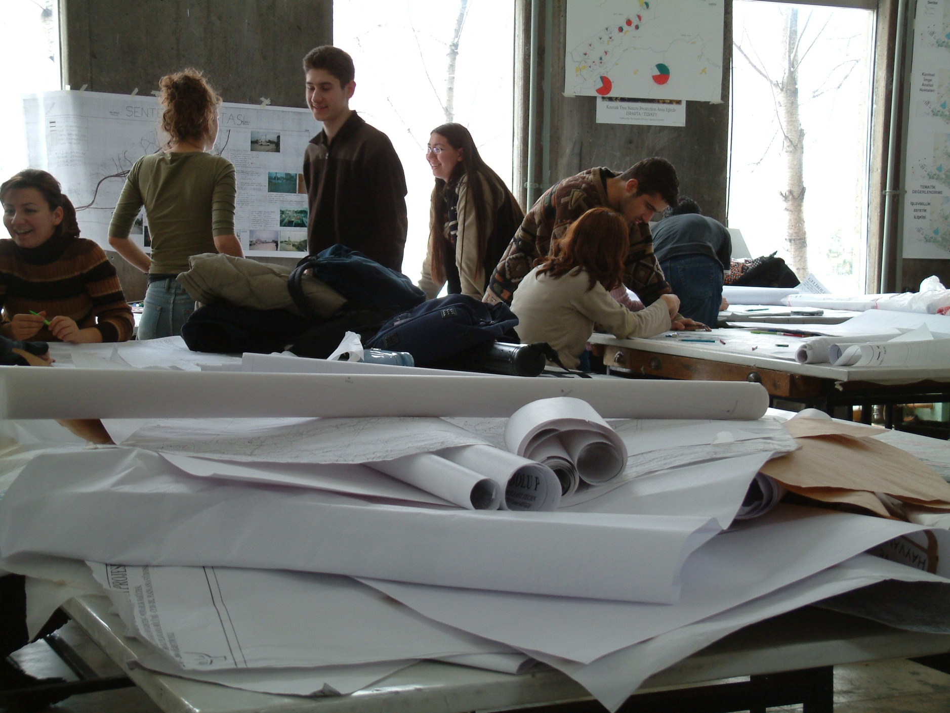

Slide 6
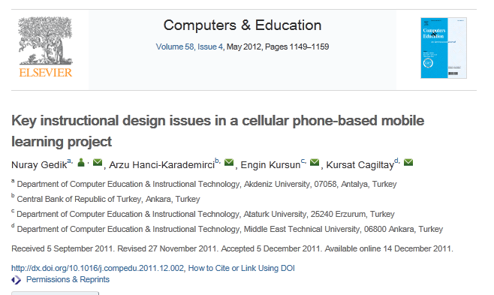
Previous Years Projects and Publications

Slide 7
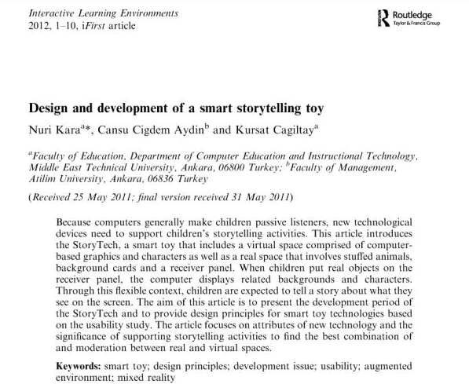
Toy Based Learning

Slide 8
Several conference presentatitons

Slide 9
Potential projects for this year
Mobile learning for adults via cell phones: TEL project for adult learning
AVEA will provide technical infrastructure
Central Bank employees
Support for f2f course
Support from Arzu
Group of 2-3

Slide 10
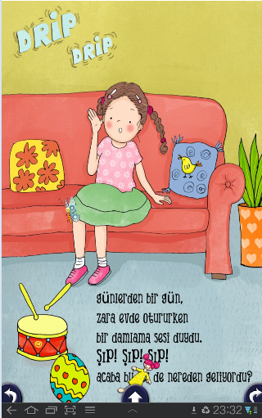
Interactive Storytelling
A project for tablets
Preschool and first graders
Story Writer: Pelin Gunes
Development for Android and IOS with suitable tool
Group of 2-3

Slide 11
Smart Toy Project
Expanding existing smart toy project
Help from Nuri Kara
Group of 2-3

Slide 12
Multitouch Table
Special education

Slide 13
Gesture Based Interaction
Kinect camera and bodily interaction
Unity

Slide 14
Logistical question
Starting 10:40? Or another day?

