Slide 1
ENG. 211 TEAM PRESENTATION
Marketing Presentation

Slide 2
Agenda
Aim
Steps to follow
Organization
Assessment
Reminders

Slide 3
Aim:
To inform the audience about a marketing-related topic
To give a presentation in a well-organized way with a proper introduction, body and conclusion
To limit the speech according to the given time constraint (5’)

Slide 4
Steps to follow:
Choose a topic related to marketing.
Narrow down your topic and prepare an outline.
Get your teacher’s approval and feedback for both the topic & your outline.
Do research.

Slide 5
Organization patterns you can use:
Classification
Chronology
Cause/effect
Reason/result
Advantages/Disadvantages
Comparison/contrast
Problem/solution

Slide 6
Some topics to inspire you:
Two main uses of the Internet as a marketing medium
Two most common communication trends in marketing
Two main consumer expectations in the IT market/ health services/ catering services/ food market/ automotive sector
Two main negative/ positive effects of commercials on consumers
Two main pricing strategies in the ….. sector
Two current digital marketing strategies
Two main responsibilities of the media in raising public awareness
Two trends in mobile marketing
The success story of Tesla Motors/ Elon Musk/ Sabanci/ Koc/ Ali Baba
The main reasons why Nokia/ Ericsson/ Skoda fell behind in the market
The history of BP/ VW/ Ikea/ IBM/ Nestle/ E-Bay/ Airbnb

Slide 7
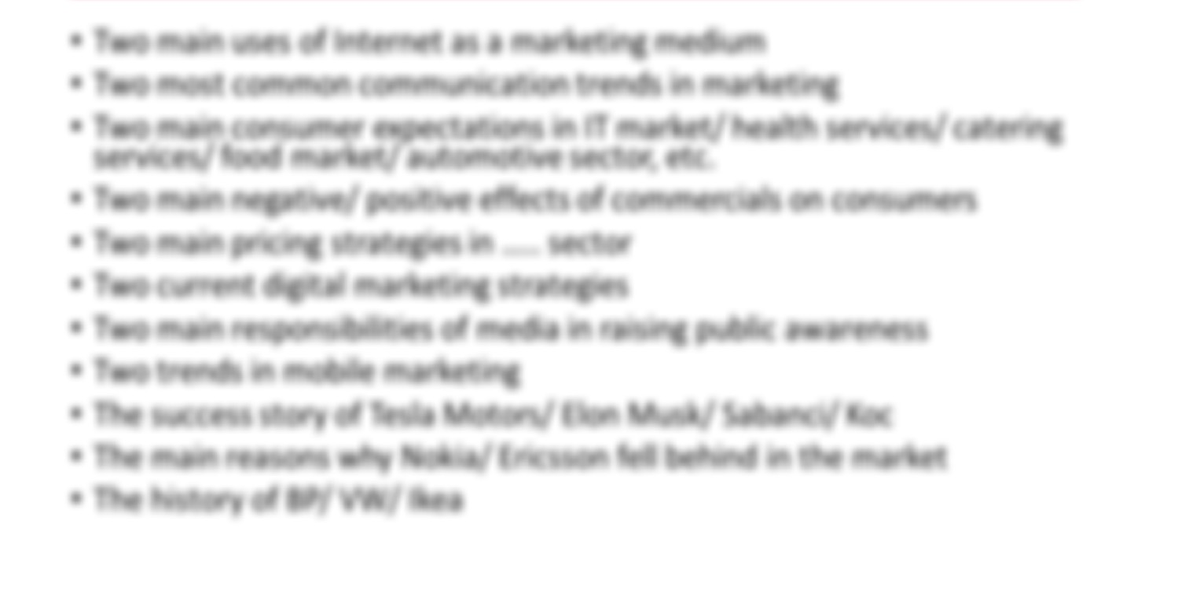

Slide 8
Assessment (15 points)

Slide 9
Assessment (15 points)
Do not forget to show your reference list in APA format.

Slide 10
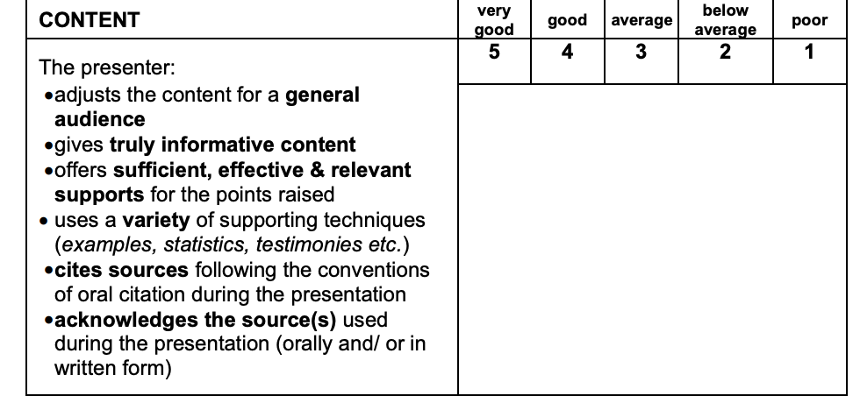
Assessment (15 points)
Minimum 1 reliable, credible and up-to-date source.
Don’t forget to acknowledge your source(s) in your presentation.

Slide 12
Assessment (15 points)

Slide 13
Assessment (15 points)

Slide 14
Reminders:
Extreme reading and memorization &
Exceeding the maximum time limit will be penalized.
Refer to Appendix 6 and YouTube for sample presentations.
Don’t forget to upload your slides on turnitin.

