Slide 1
Table Topics

Slide 2
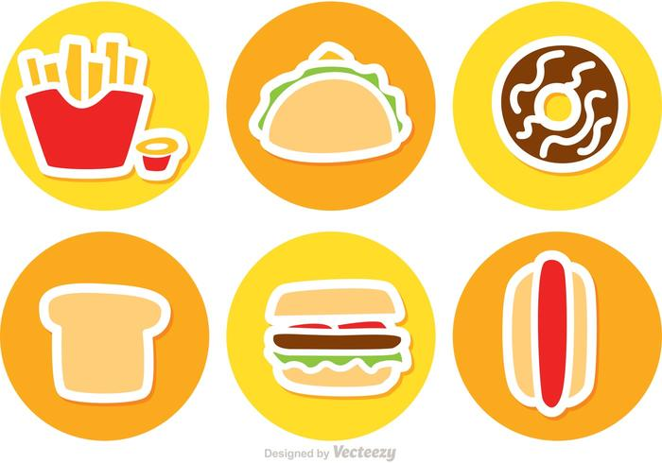
Would you stop eating all junk food to live five years longer?

Slide 3
Who’s the funniest person alive?

Slide 4
What’s on your bucket list?

Slide 5
Which fabulously impractical car would you like to own?

Slide 6
What three adjectives would your family use to describe you?

Slide 7
If you could work as an assistant to anyone for a year who would you choose?

Slide 8
What was the best sitcom ever?

Slide 9
What do you miss about childhood?

Slide 10
In which activity would you like a lesson from a friend?

Slide 11
Do you have any superstitions?

Slide 12
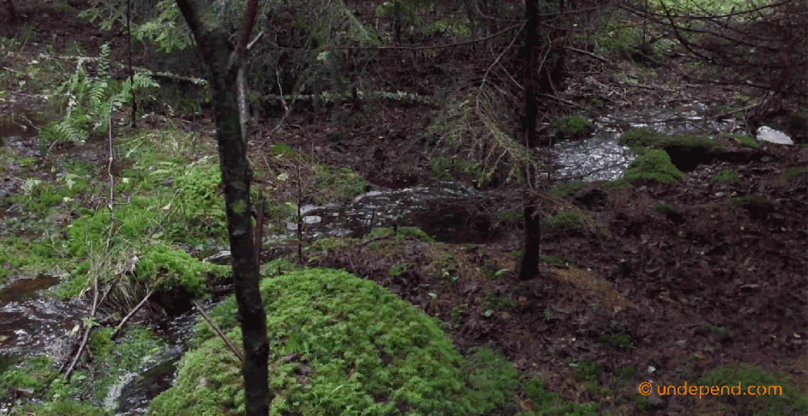
Would you be likely to survive in wilderness?

Slide 13
What obligation do you believe you have to your country?

Slide 14
If you got a tattoo what would
you get and where would you put it?

Slide 15
Which sports team has the best mascot?

Slide 16
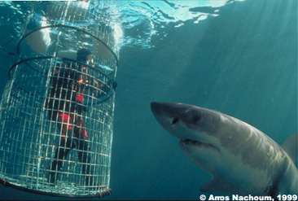
If you knew you wouldn’t get hurt would you rather skydive or view sharks from an underwater cage?

Slide 17
If money were no object what kind of party would you throw?

Slide 18
In what era would you like to have grown up?

Slide 19
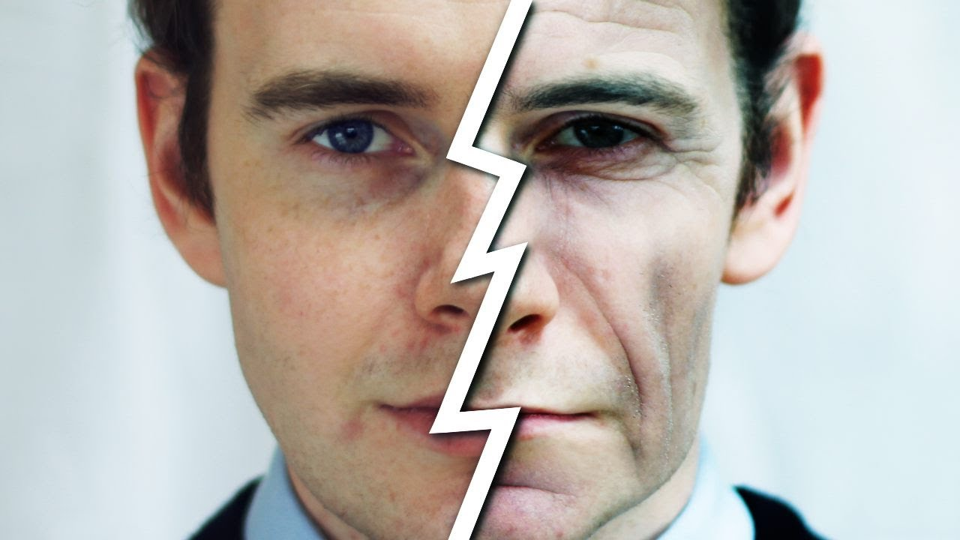
When you were young what did you want to be when you grew up?

Slide 20
Would you rather be a great musician, artist or athlete?

Slide 21
What would you most like to do for someone else if you had the money and time?

Slide 22
What would you try if you had no fear?

Slide 23
What was your favorite game to play as a child?

Slide 24
Who’s the best teacher you’ve had?

Slide 25
If you could design and build a room of your own what would it be like?

Slide 26
If you didn’t have to worry about money what would you do with your life?

Slide 27
What one goal do you hope to accomplish this year?

Slide 28
Do you let the little things get in the way of the big things?

Slide 29
If you went on a volunteer vacation who would you most like to help?

Slide 30
Who do you think is the most inspirational person alive today?

Slide 31
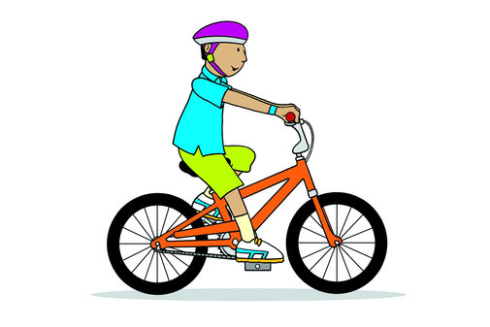
Who told you how to ride a bike?

Slide 32
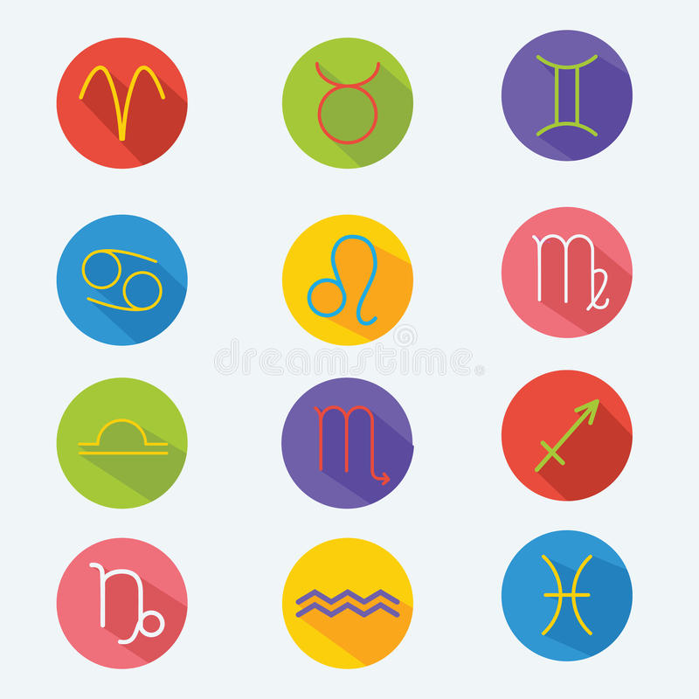
Do you possess any of the qualities of your astrological sign?

Slide 33
Would you rather visit a big city or the countryside?

Slide 34
What’s your dream job?

Slide 35
If you knew that you were going to inherit a fortune how would your plans for the future change?

Slide 36
Which of your personality traits would you like to change?

Slide 37
What do you dream your life will be like in ten years?

Slide 38
Where would you choose to live if you had to leave your country?

Slide 39
What’s your proudest accomplishment?

Slide 40
What makes a house a home?

Slide 41
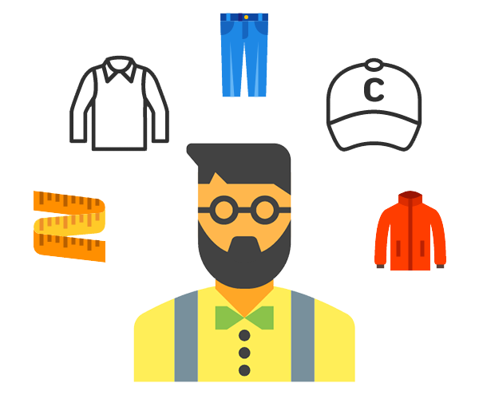
What fashion trend you followed was very cool then but now looks ridiculous?

Slide 42
What was your favorite childhood meal?

Slide 43
Have you ever had an experience that led you to believe in angels or ghosts?

Slide 44
If you could do something dangerous just once with no risk what would you do?

Slide 45
If you could master one instrument which would it be?

Slide 46
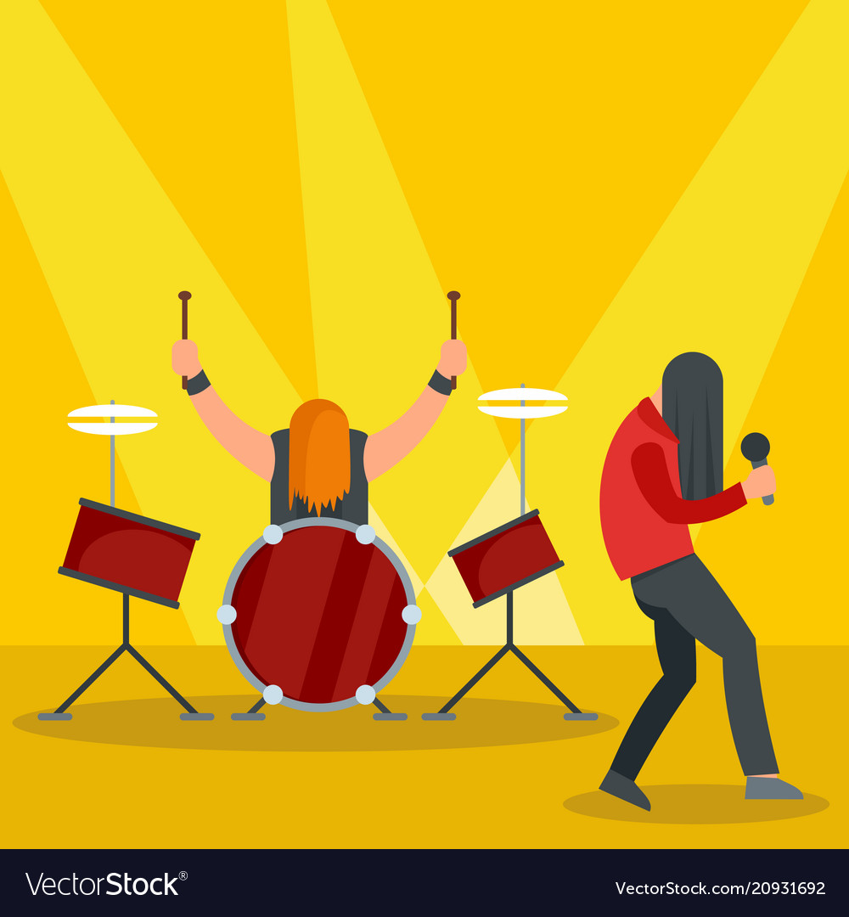
If you could have front row tickets to any concert who would you like to see?

Slide 47
If you could be brilliant in one subject which would you choose?

Slide 48
Which historical time period would you most like to visit?

Slide 49
Which book dramatically influenced your life?

Slide 50
Which celebrity do people say you resemble?

Slide 51
If you could have any view from your back porch what would it be?

Slide 52
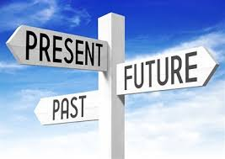
Do you tend to live in the past, present or future?

Slide 53
What’s your favorite fast food meal?

Slide 54
What’s the most beautiful place you have ever seen?

Slide 55
If you could spend the weekend in any city which would you choose?

Slide 56
If you had five more years to live would you change anything about your life?

Slide 57
What do you most admire about your parents?

Slide 58
What’s the most beautiful drive you have taken?

Slide 59
If you needed to change your name what would you choose?

Slide 60
What changes have you made to reduce your impact on the environment?

Slide 61
What do you complain about more than anything else?

Slide 62
What are your simple pleasures?

Slide 63
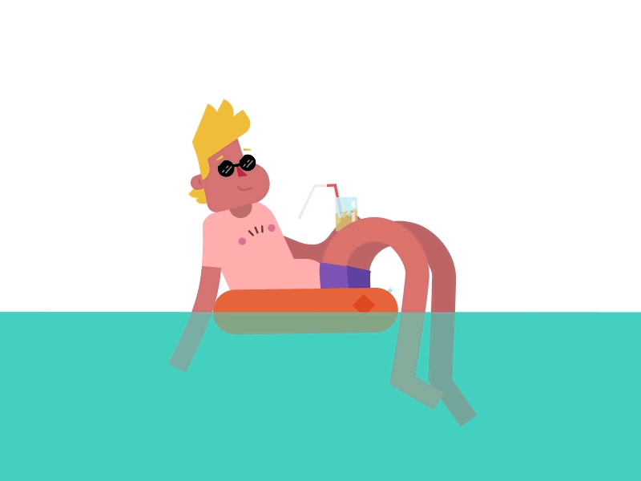
What was the best vacation you ever took?

Slide 64
What’s your favorite dessert?

Slide 65
If you could give all human beings one virtue which would you choose?

Slide 66
Which historical sporting event would you like to witness?

Slide 67
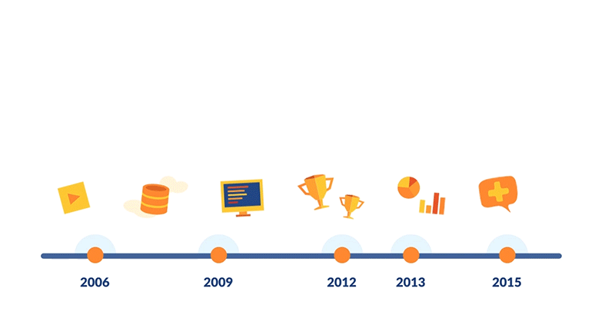
Would you rather age forward or backwards from this point?

Slide 68
What do you think is the ideal age?

Slide 69
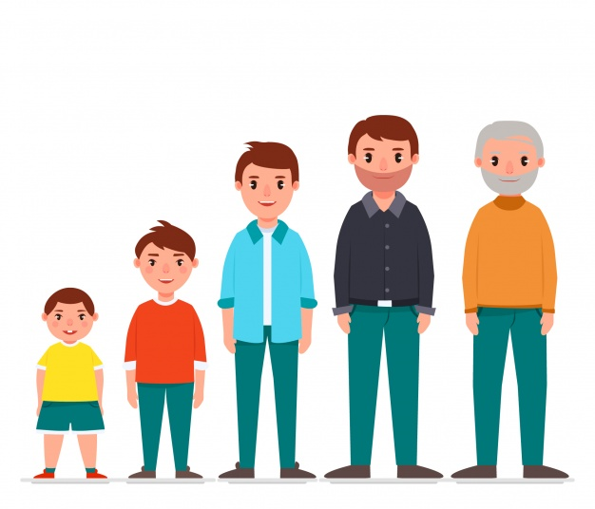
How would you like to spend
your elderly years?

Slide 70
What do you love about your hometown?

Slide 71
When you are down
what makes you feel better?

Slide 72
How will our culture change in the next 100 years?

Slide 73
Where would you most like to travel?

Slide 74
If you could be any athlete for a single game who would you choose?

Slide 75
What would you most like to learn how to do on a computer ?

Slide 76
What pets have you had in your life?

Slide 77
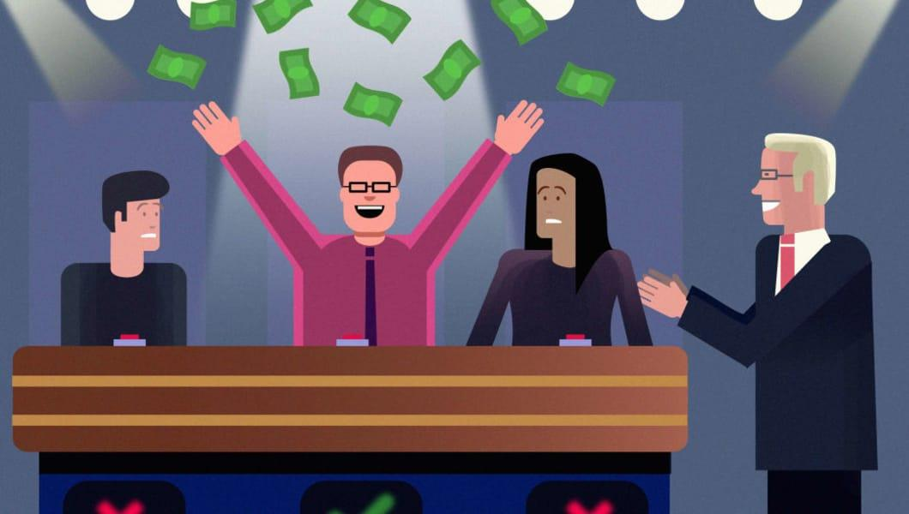
If you could appear on any game show which would you choose?

Slide 78
In your opinion what are the seven wonders of the world?

Slide 79
What’s the most amazing weather you have ever seen?

Slide 80
What have you lost that you would like to find?

