Slide 1
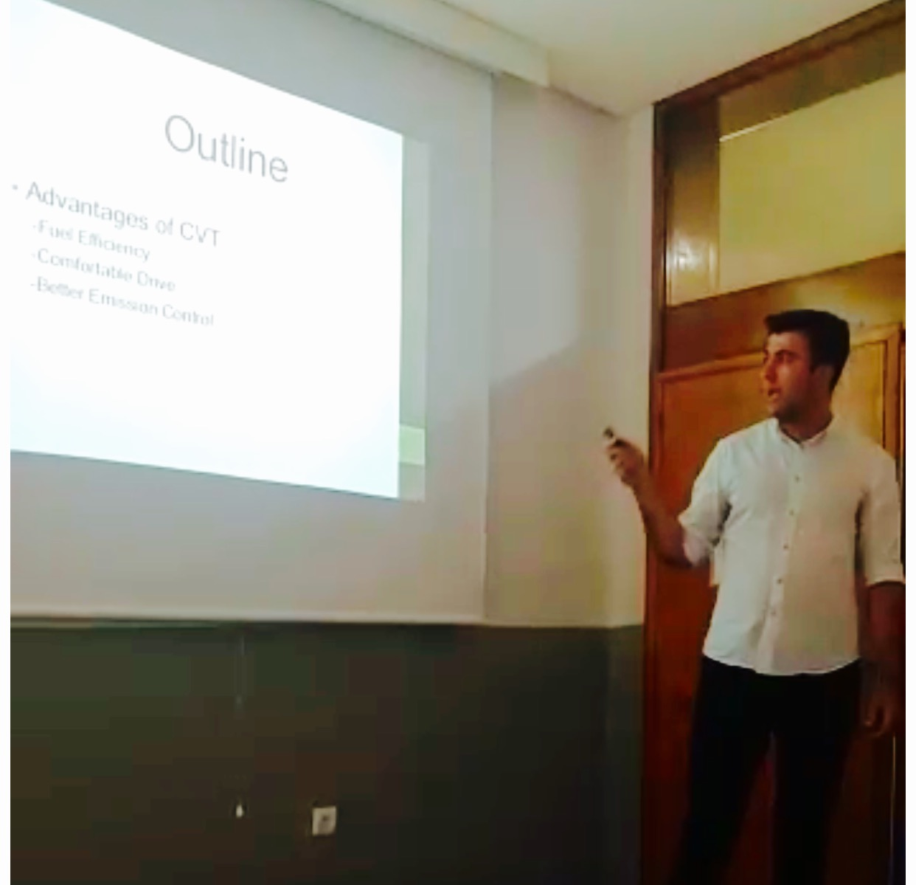
211
Academic Oral Presentation Skills

Slide 2
Aim
Units and Themes
Point allocation

Slide 3
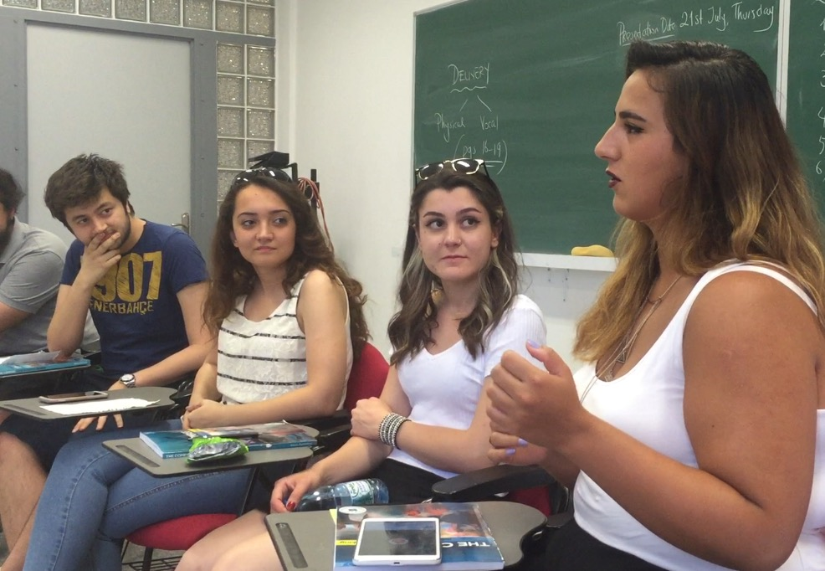
Aim:
Speaking skills
Academic presentation skills

Slide 4
Themes:
1. Mind
2. Art
3. Marketing
4. Technology and science

Slide 5
presentations | point allocation | time | citation
mind | Non-graded | 2-3 min | -
marketing | 10 | 5 min | 1
science & technology | 20 | 6 min | 2
final | 30 | 7 min | 3

Slide 6
reflection task | 5 | on your performance
speech analysis | 5 | assigned video presentations
speaking task 1 | 5 | debate/ graphic-citation/ roleplay/ ad/ etc.
speaking task 2 | 5 | debate/ graphic-citation/ roleplay/ ad/ etc./

Slide 7
presentations | point allocation
mind | Non-graded
marketing | 10
science and technology | 20
final | 30
MIDTERM | 20
reflection task | 5
speaking task 1 | 5
speaking task 2 | 5
speech analysis | 5

Slide 8
Requirements
regular attendance
active participation
if absent on a graded task→ medical report is a must
marketing, science and technology and final slides→ Turnitin, if not they won’t be graded

Slide 9
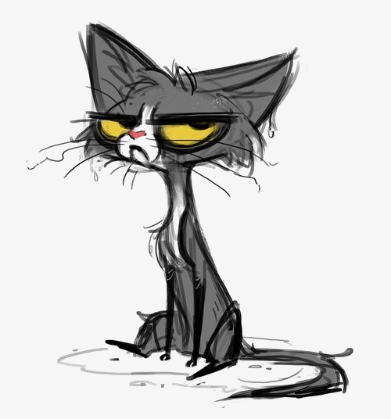
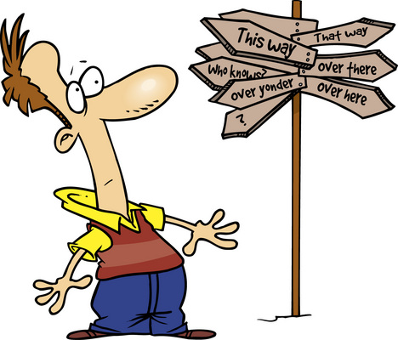
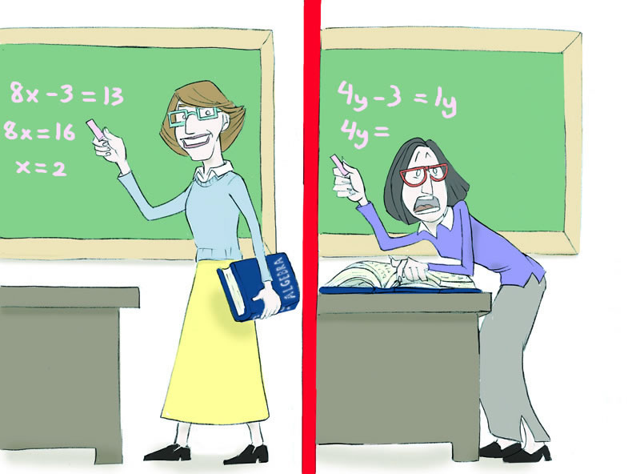
What doesn’t count as an excuse for absenteeism:
My roommate just broke up with his girlfriend.
I couldn’t find a parking spot.
I found a stray kitten on the way to class.
I couldn’t find the classroom.
I have another class during the same hours.

Slide 10
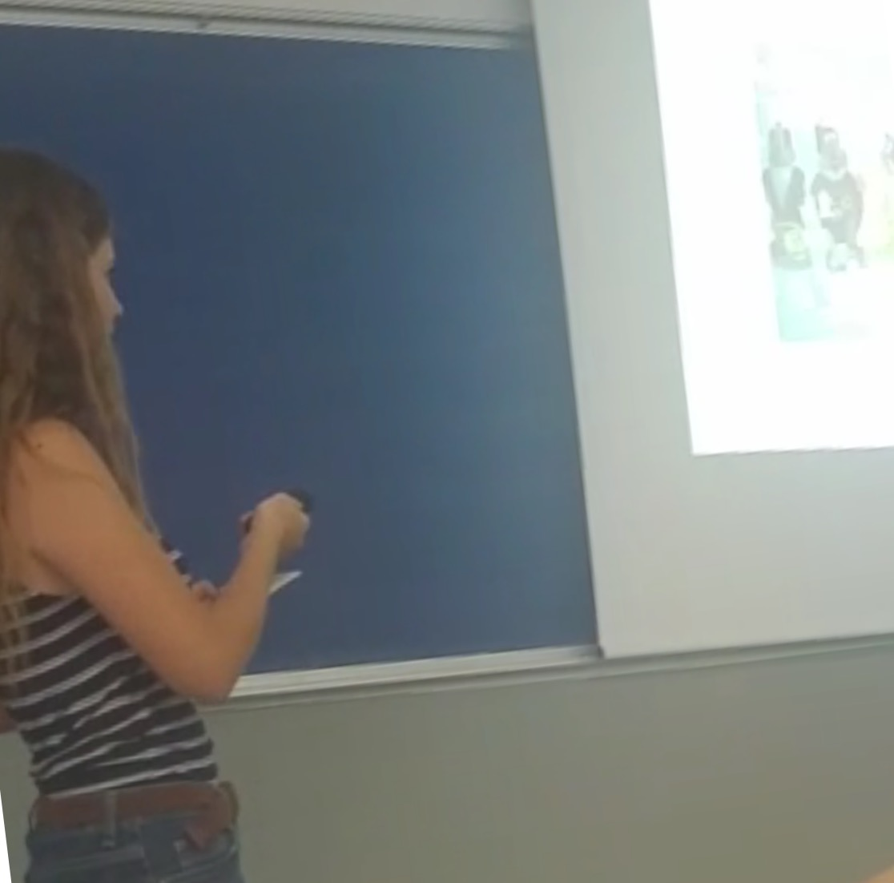
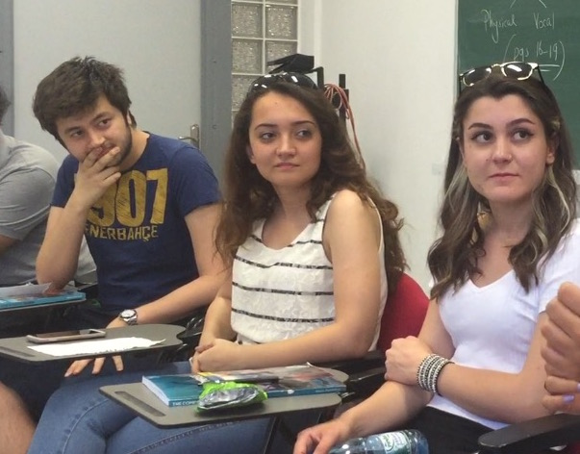
MAKE THE BEST OF 211!

