Slide 1
Presenting Numerical Data

Slide 2
Agenda:
Why use graphs?
Types of graphs
Delivery of graphs
Sample graphs

Slide 3
Why use graphs?

Slide 4
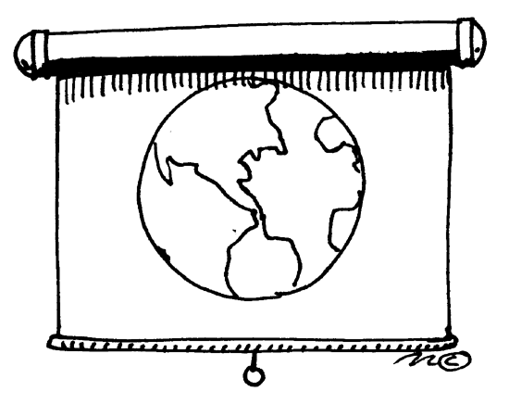
Numerical data shows
spatial information
steps in a process
numerical relationships

Slide 5
Graphics help the presenter to
increase credibility
clarify, emphasize, summarize & organize information
capture attention
remember information
Graphics help the audience to
grasp information more easily
remember information

Slide 6
Types of Visual Representations

Slide 7
Vertical Axis
Column
Horizontal Axis
Bar Graph

Slide 8
Undulating Line
Curve
Fluctuating Line
Line Graph

Slide 9
Segments
Pie Chart
Legend

Slide 10
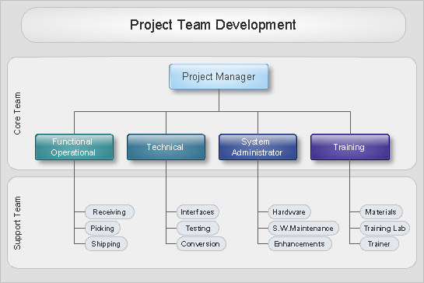
Organigram

Slide 11
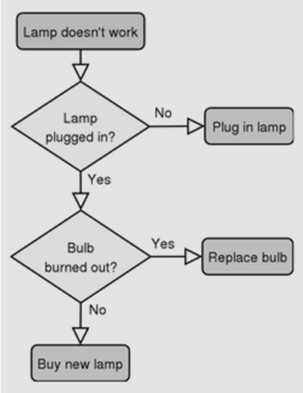
Flow Chart

Slide 12
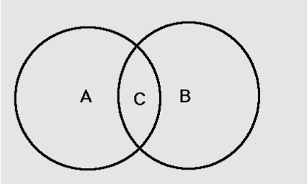
Venn Diagram

Slide 13
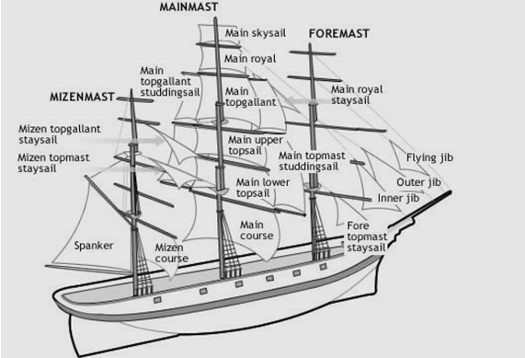
Diagram

Slide 14
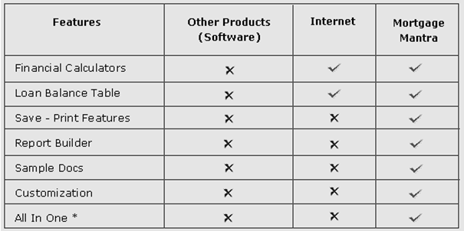
Table

Slide 15
Delivery of graphs
Map

Slide 16
Venn Diag. | Pie Chart | Table | Line Graph
Organigram | Bar Graph | Map | Flow Chart
Sequence of a process
Change of a trend in time
Relationship of parts to the whole
Location of places
Rankings
Summary in list form
Hierarchical structure
Intersecting qualities
MATCHING

Slide 17
Venn Diag. | Pie Chart | Table | Line Graph
Organigram | Bar Graph | Map | Flow Chart
Percentages of Anatolian high school students-
in engineering programs at METU
2. Increase in the amount of money spent by Turks
on health care since 1993
3. Wing patterns of various species of butterflies
4. Layers between the President
and Research Assistants at METU
5. How to apply for a job in a computer company
MATCHING

Slide 18
Venn Diag. | Pie Chart | Table | Line Graph
Organigram | Bar Graph | Map | Flow Chart
6. Equipment and techniques of rock climbing
7. Main routes of Ankara metro and Ankaray
8. Distribution of METU students doing MA/MS in Europe
9. The new design of the National Library building

Slide 19
Delivery of graphs

Slide 20
Upward Movement
to increase/rise/ go up/ to grow/
expand/ rocket/ boom/ climb

Slide 21
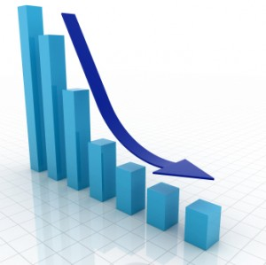
Downward Movement
to decrease/ fall/ drop/ decline/
go down/ to contract/ collapse/ slump

Slide 22
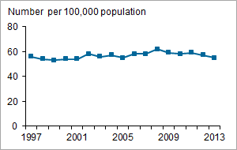
No Change
to remain constant/ stable/
to stay the same/ at the same level

Slide 23
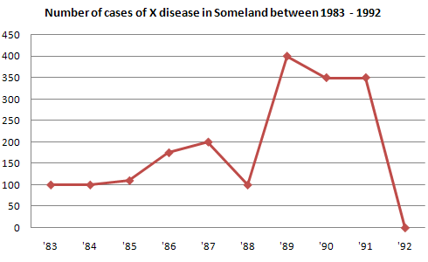
Degree of Change
dramatically/ considerably/ significantly/ moderately/ slightly

Slide 24
Speed of Change
rapidly/ quickly/ suddenly/ gradually/ steadily/ slowly

Slide 25
Always mention
The source of the graph
What the representation shows
What X & Y axes/ segments represent
Which part the audience should look at
(use a laser pointer or animation)
5. Why what you refer to matters

Slide 26
Reminders:
Do not reveal your graph before you refer to it.
Write the title of your graph.
Cite your source under your graph.
Use legible font size to write what each color/ axis represents.
Do not use 3D graphs as they are harder to understand.
Keep your graph as simple as possible.
Refer to the part that matters with animation or a pointer.

