Slide 1
APA

Slide 2
APA IN-TEXT REFERENCE
“The writing process has brought about much change in the way writing is taught in schools.”
(Jones, 1994, p. 23)

Slide 3
“In 19th century Bali the ruler’s palace becomes a temple.”
(Geertz, 1980, p. 109)

Slide 4
NO AUTHOR SOURCE
If there is the organization name instead, use it in the place of the surname;
(UNESCO, 1999, para. 4)
If only the title is known, use it in the place of the surname;
(“An Effective Leader”, 2000, p. 2)

Slide 5
NO DATE: n.d.
(UNESCO, n.d., para. 4)
NO PAGE: paragraph no; “para.”
(Jackson, n.d., para. 1)

Slide 6
PAGE NO: “p. and pp. 1-3”
If the info borrowed is on a single page: “p.” before the page no.
If the info borrowed is on more than one page: “ pp.” (double p) before and ‘-’ between the page numbers

Slide 7
Freud introduces the powerful rival emotions of love and hate as he says:
“The true prototypes of the relation of hate are not derived from sexual life.”
(as cited in Fromm, 1973, pp. 489-490)

Slide 8
LONG QUOTATIONS (longer than 40 words/3 lines: block format)
In his 1986 study, Rosecrane argued that traditional
military expansion strategies were not successful:
After 1945... The threat of an all-out military conflict (including the use of nuclear and thermonuclear bombs) became catastrophic, and such wars as did occur took on a more limited character.
(Rosecrane, 1986, p. 47)

Slide 9
Try to avoid long quotations in your presentations,
since understanding written language may be challenging for the audience to follow.

Slide 10
ELLIPSIS (...): to avoid irrelevant parts
“Most of the world’s Muslims today ... are not Arabs and cannot read Arabic.”
(Lipmann, 1989, p. 58)

Slide 11
SQUARE BRACKETS [ ]: to add words
Bundy’s “failure in repression [resulted] in the inability to inhibit powerful [sadistic] needs” (Franzini & Grossberg, 1998, p. 60)

Slide 12
AMPERSAND (&)
“The federal government has launched a five-year study to define the threat.”
(Canby & Blair, 1981, p. 86)
PS: Used only IN PARANTHESES and
END TEXT FORMS
for more than one writer sources.

Slide 13
et al. : 2nd reference to the same multi-writer source
“A young girl named Leslie, who attempted suicide, said ‘There was so much pain, I had to get away from it.’ ”
(Udagawa, in Cihan et al., 2002, p. 43)
PS: list all the surnames in the first reference to the source

Slide 14
[sic]: to show the mistakes made by the original writer
“History shows that men are not more intelligent then [sic] women.”
(Halder, p. 34)

Slide 15
EMPHASIS in italics
Adolescents who fail to receive guidance from their parents are likely to rely on peers for emotional gratification, advice and companionship, to anticipate a relatively ‘unrewarding future, an to engage in anti- social activities’ (emphasis added).
(Elder, 1975, p.31)

Slide 16
Single Quotation Marks (‘......’); secondary citation within a citation
“As I continued to think about the matter I gradually gained a measure of satisfaction from the label. Was not Jesus extremist for love: ‘Love your enemies, bless them that curse you, do good to them that hate you....’ ”
(King, 1960, p.61)

Slide 17
‘as cited in’ + your first hand source details
In his three essays on the Theory of Sexuality, Freud introduces the powerful rival emotions of love and hate. “The true prototypes of the relation of hate are not derived from sexual life”
(as cited in Fromm, 1973, p. 489)

Slide 18
APA → designed for research papers
APA → does not contain any guidelines on preparing APA Style presentations
Cite references for images if they represent data.
Your end-text reference list must include the images cited.
Create a separate slide titled "Photo credits" or "Image Sources".

Slide 19
How to cite images
If your presentation is presented only to your instructor and class, you don't need to obtain copyright permission to use the images unless they represent data
because your use falls under the Fair Dealing Policy.

Slide 20
Sources for public use images:
To avoid the hassle of copyright and obtaining permission, consider using clip art and images that you have created
http://www.flickr.com/creativecommons/
Google Advanced Image Search allows you so filter results by usage rights (e.g., free to use or share):
https://www.google.com/advanced_image_search
https://openclipart.org/

Slide 21
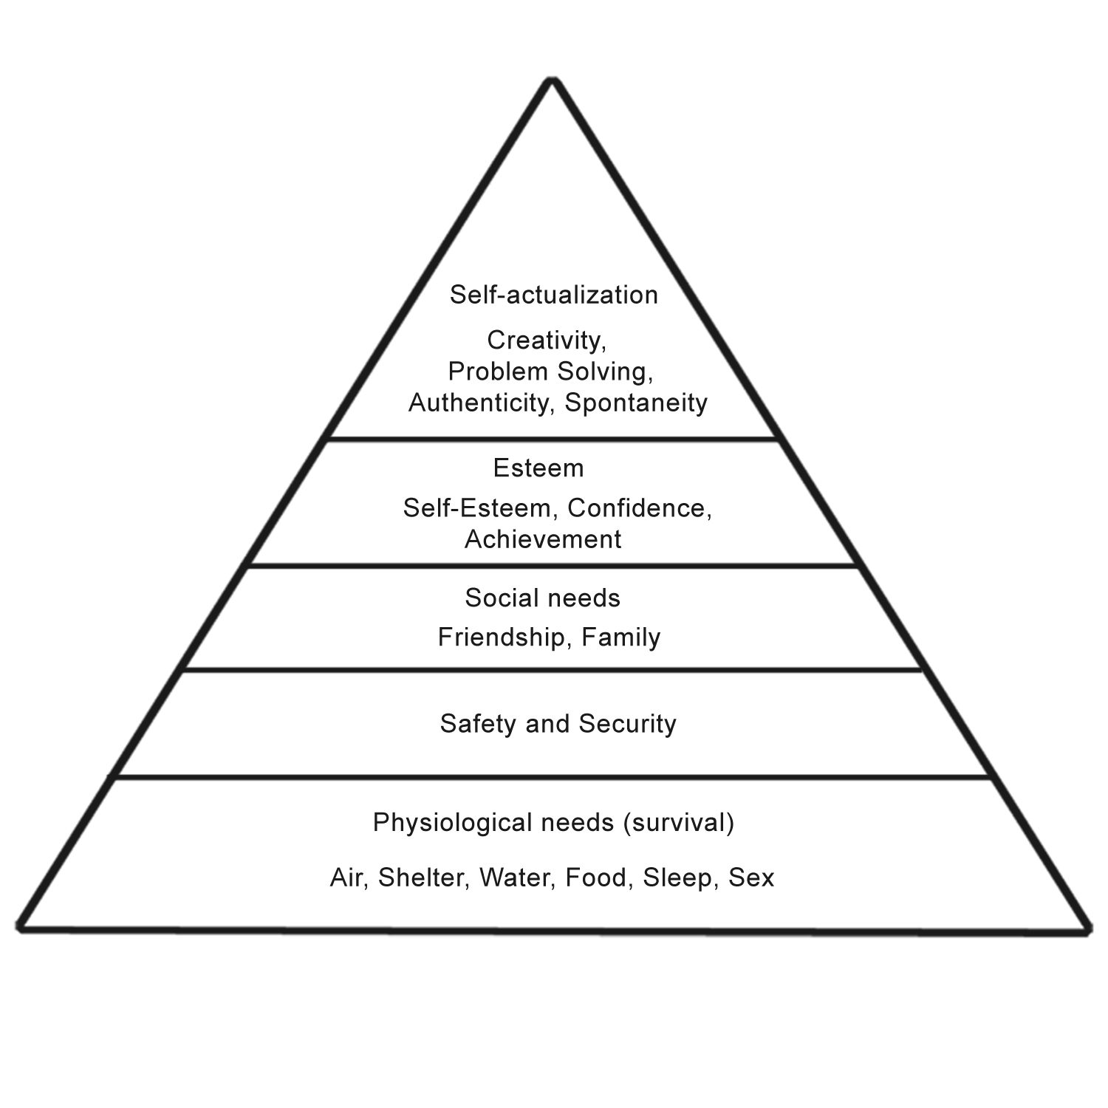
For images the credit should appear in the figure caption.
Orally cite first!
Caption: Title of the picture
Figure 1. Maslow's Hierarchy of Needs (Stikoudi, 2016, p. 21).

Slide 22
SOCIAL LIFE
Orally cite first!
No p.# because the pie chart is not directly copied and pasted.
Figure 2. METU students’ Free time activities (Forbes, 2015)

Slide 23
Worthington Engine
Figure 1. Worthington Engine. (Encyclopedia Britannica, 2007)

Slide 24
APA END TEXT REFERENCE
On a separate slide
Alphabetically ordered
NO bulleting
Second lines indented

Slide 25
Title formats
1- ITALISATION
Books, journals, newspapers
2- CAPITALISATION:
A- BOOKS: ONLY the FIRST LETTER of the FIRST
WORD in the title and the subtitle
B- JOURNALS: FIRST LETTERS of ALL the
WORDS in the title

Slide 26
Portraits of power → book title
Journal of Psychology → journal title

Slide 27
End-text reference for an image
References:
Artist Surname, First Initial. Second Initial. (Year).Title of
the artwork [Type of work]. Retrieved from URL (address
of web site)
Reference (No Author)
Title of work [Type of work]. (Year image was created).
Retrieved from URL (address of web site)

Slide 28
End-text reference for an image
Example:
Baumel, A. (2010). Cholera treatment center in Haiti [Online image].
Retrieved from https:www.doctorswithoutborders.org

Slide 29
Photo credits
Della Francesca, P. (1451). Saint Jerome venerated by Girolamo Amadi [Painting].
Retrieved from https://www.wikiart.org/en/piero-della-francesca/st-jerome-
and-a-donor-1451
Du Maurier, G. [ca. 1881]. George Du Maurier [Drawing]. Retrieved from http://www.
npg.org. uk/collections
Giotto. [ca. 1310 ACE]. Scenes from the New Testament: Flight into Egypt [Fresco].
Assisi, Italy: Sacro conventodi S. Francesco.
Hipkins, G. (2006). The shaman (blue) [Photograph]. Retrieved from http://collections.
tepapa.govt.nz/object/778464
Marc, F. (1912). The red deer [Painting]. Retrieved from http://www.artstor.org/
Modigliani, A. (1919). Elvira resting at a table [Painting]. St. Louis, MO: Saint Louis
Art Museum.
Raverat, G. (2008). Travellers [Woodcut].Chapel Hill, NC: Ackland Art Museum.

Slide 30
The rationale behind citing your sources is to credit them and to help your audience track them if they need to.

Slide 31
For further info on APA citation format:
Click here

