Slide 1
SAMPLE GRAPHS TO DISCUSS

Slide 4
Let’s get serious!

Slide 5
Problems

Slide 6
Problems:
Minor gridlines-unnecessary
Font-too small
Title-missing
Shading-distracting
No reference

Slide 7
Improved Version
Figure 1. Item Sales (Sancar, 2018)

Slide 8
Problems
Figure 6. Running Speed of Common Farm Animals

Slide 9
Improved Version
Running Speed of Common Farm Animals
Figure 6. Running Speed (Farm Animals Statistics, 2014)

Slide 10
Problems
Figure 12. Typical Household Expenditures

Slide 11
Improved Version
Figure 3. Household Expenditures (US Bureau of Labor Statistics, 2014)

Slide 12
TALK ABOUT IT

Slide 13
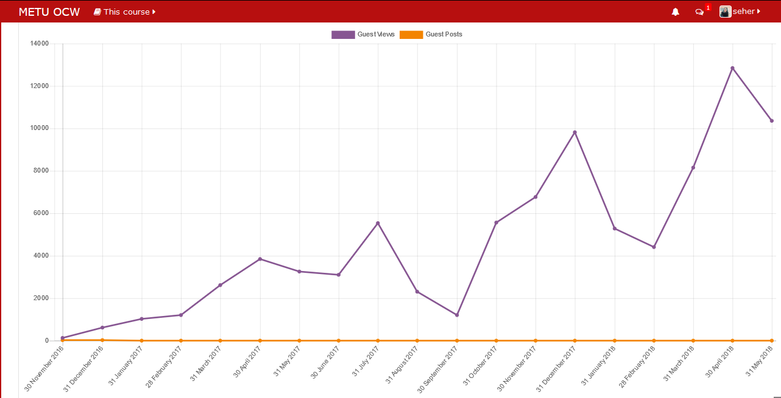
METU Open Courseware
2016-2017 Spring semester
2016-2017 Summer school
2017-2018 Fall semester
2017-2018 Spring semester
Figure 3. Clicks on METU ocw (ocw.metu.edu.tr)

Slide 14
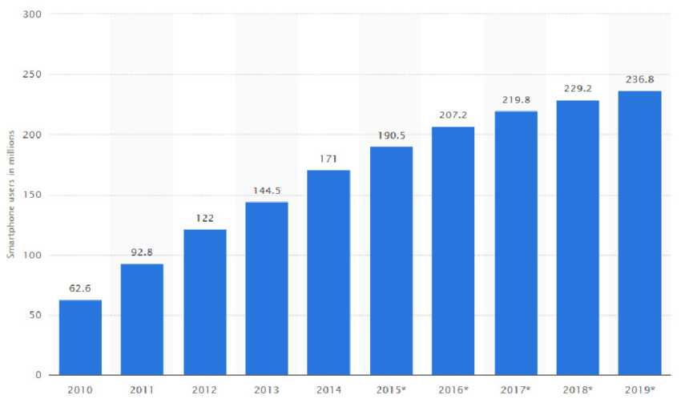
The Increasing Number of Smartphone Users

Slide 15
*National Institute of Health, 2015

Slide 16
CERN Human Resources Department. (2017, May 24). CERN Personnel Statistics 2016 (Rep.). Retrieved November 10, 2017, from http://cds.cern.ch/record/2265782/files/CERN-HR-STAFF-STAT-2016.pdf?subformat=pdfa&version=1

Slide 17
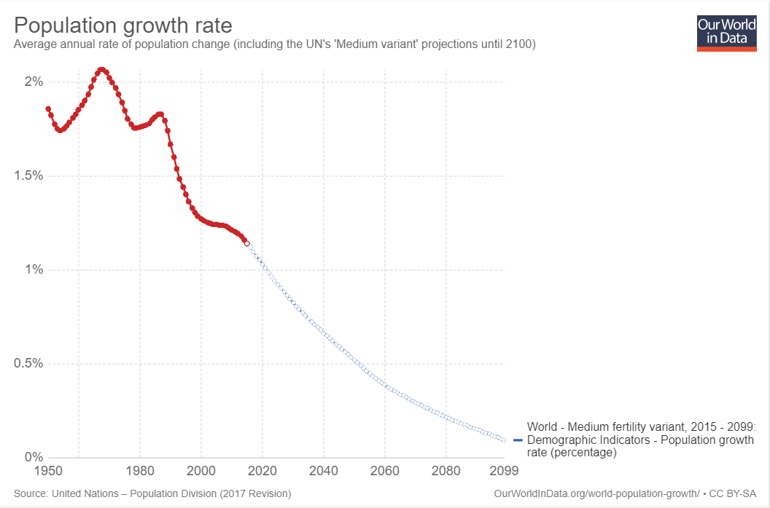
Source: MEDIUM PROJECTION – UN POPULATION DIVISION

Slide 18
Coffee Consumption Over Some Countries
Source Euromonitor.com

Slide 21
Lowest and Highest Points in University Exam
Points

Slide 25
Yök Atlas 2016

Slide 28
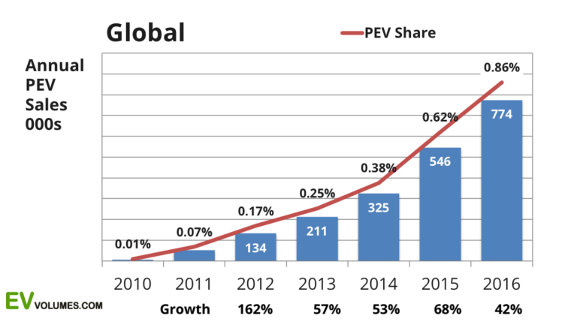
Global PEV Sales
Worldwide Plug-in Electric Vehicle Sales per annum

Slide 29
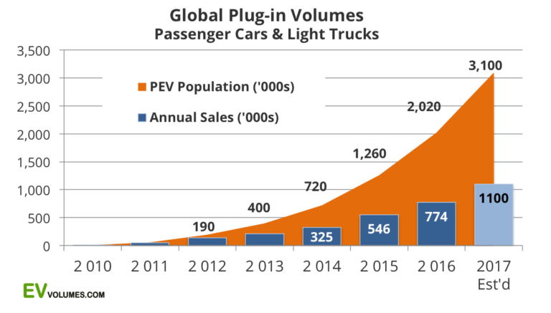
Global Total PEVs
Total Number of Plug-in Electric Vehicles in the World

Slide 30
Racism Against Black People
Source: Supreme Court of the United States (2016)

Slide 31
The Composition of the U.S. Population
Source: United States Census Bureau (2016)

Slide 32
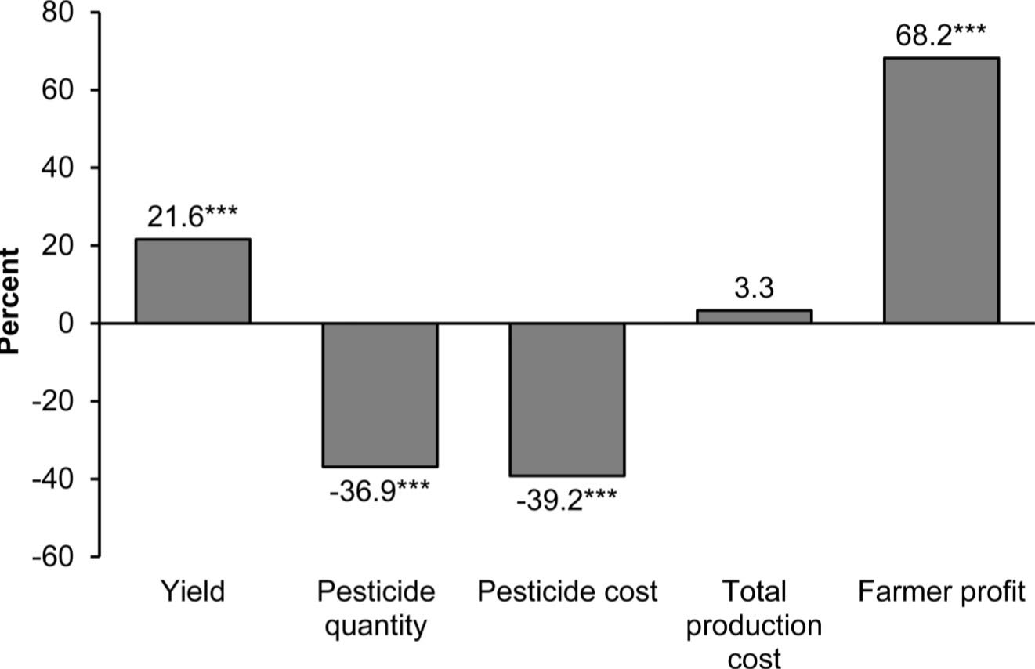
Figure 1. Impacts of GM crop adoption.Average percentage differences between GM and non-GM crops are shown. (Klümper & Qaim, 2014)

