Slide 1
UNIT 3:
PRESENTATION SKILLS
PARTS OF A PRESENTATION

Slide 2
OUTLINE
INTRODUCTION
  Components
  Attention-getting techniques
BODY
  Supporting techniques
CONCLUSION
  Components
  Leaving a memorable impact techniques

Slide 3
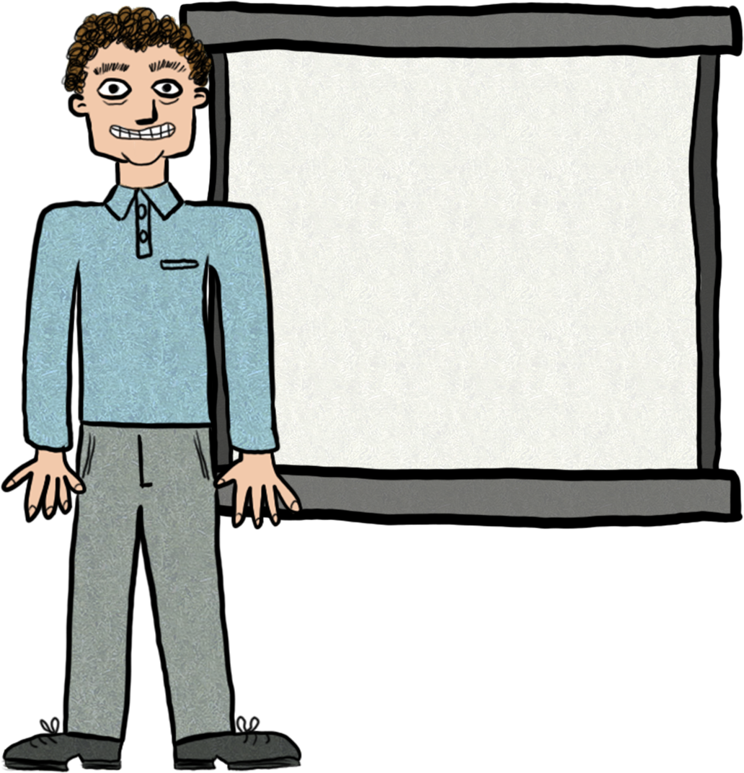
INTRODUCTION
  Especially important because:
  first impression
  a bridge to the main part
  psychological preparation
  sparks the interest of the audience
  creates a friendly atmosphere

Slide 4
What are the components of the introduction below?
Did you know that
only last year 30% of all new companies couldn’t survive in their market because they took the
demographic properties
of their consumers for granted?
Good morning!
I am Ahmet Tarkan.
Today I’d like to talk about two main consumer expectations in the consumer market.
Here’s my outline:
Userfriendliness
Affordibility

Slide 5
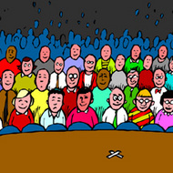
Why need an attention getter?
to motivate
to create curiosity
to convince
to create a sense of familiarity
to focus on the topic immediately

Slide 6
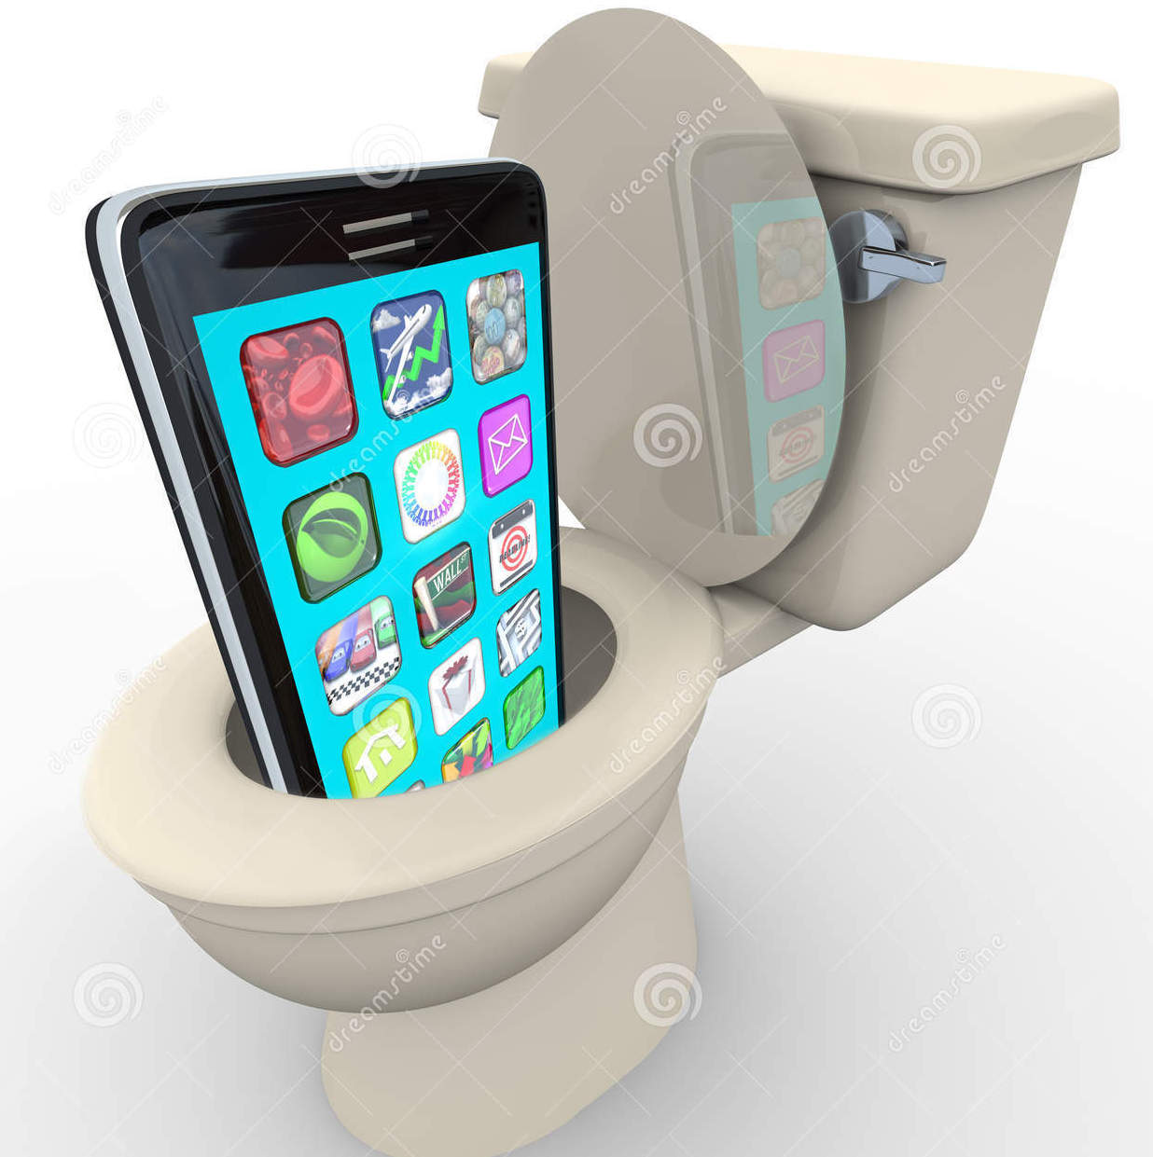
Attention-Getting Techniques
1. Rhetorical Question
  What do you do if you drop your phone into the toilet bowl?
  Have you ever swum in a freezing river at 5am?
  Do you know how to survive on campus without spending money at all?

Slide 7
2. Quotation
What do you think the presentation will be about?
  It is common to hear today that
  “Shopping is cheaper than going to a psychiatrist!” (Irma, 2016).
  “Pop culture is about supply and demand; that is marketing” (Drucker, 2015).
  “Being told ‘no’ has become a source of inspiration”
  (Copperfield in Szcerba, 2015).

Slide 8
3. Startling Statement
What do you think the presentation will be about?
  Out of 7000 people bitten by venomous snakes, only 5 die.
  In ten minutes, a hurricane can release more energy than all of the world’s
  nuclear power plants.
  Identity fraud is one of the oldest crimes.

Slide 9
4. Anecdote or Story
What do you think the presentation will be about?
  Turker was finally ready to purchase a home. He spent years putting money into a savings account. He visited the bank to inquire about a mortgage, but he discovered something startling: He was actually in debt for a home loan, and had 40,000TL credit card debt! Like many, he is a victim of identity theft. Instead of preparing to move into a new home, he began the long journey to restore his good name and to reclaim his identity. Identity theft is a serious problem that claims millions of innocent victims.

Slide 10
5. Suspense
What do you think the presentation will be about?
  The moon had an unnatural light hanging in the clouds. The night was grey. The large house made her feel threatened. At that moment she realised that she was alone. For the first time ever, no friends, no family were there to tell her it was going to be ok. There she stood, staring into the hole in the ground. All was quiet...all was still. She took baby steps closer. Shuffling as close as she dared to, she peered cautiously into the hole. All was black.

Slide 11
6. Definition
What do you think the presentation will be about?
Identity is the distinguishing character or personality of an individual,
and when one is a victim of identity theft, it is this distinguishing character that is stolen.

Slide 12

7. Visuals
What do you think the presentation will be about?
We all enjoy them, don’t we?
But actually fireworks are an environmental disaster.

Slide 13
8. Misdirecting the audience
  During the Middle Ages in Europe and the Middle East there was much armed conflict between Christians and Muslims. Christians called these conflicts the Crusades because they were fighting under the sign of the cross to save the holy lands. However, the true reason for fighting for these lands was less than holy. It was mainly a desire for economic gain.

Slide 14

BODY
the main part
details of the main points
explain, support, and defend

Slide 15

Supporting Techniques
supporting materials must be
  accurate
  reliable
  relevant

Slide 16
Supporting techniques
1. Examples
  should be:
  vivid and clear
  representative ----> can be generalized
  can be:
  comparison, contrast, statistics, etc.
  anecdotal, factual or hypothetical

Slide 17
2. Analogies
  Your short term memory is like the RAM on a computer: it records the information in front of you right now.
  Books are like adventures, except you never have to leave your home for them.

Slide 18

3. Statistics
What do you think the presentation will be about?
  Of the 53,487 people involved in plane crashes in the US between 1983-2000 51,257 survived!
  In rural areas, rats eat 20% of the total crops, and 20% of the grains in storage.

Slide 19
4. Testimony (Authority Opinions)
  Jones’ study published in 2008 suggests that many university students have problems citing their sources correctly due to not being able to follow the recent updates in the APA citation manual.

Slide 20
What are the components of the conclusion below?
So that concludes
what I wanted to talk about today.
The reasons behind the fall of overhead projectors are apparently very obvious now.
They are not user friendly and in the long run too expensive to maintain and use compared to projectors.
Believe me, we will survive without them when presenting!
Thank you for listening to me.
Do you have any questions?

Slide 21
Leaving a memorable impact techniques
What do you think the presentation was about?
  So, what else do you think the future of democracy will bring in developed countries?
  It seems, technology will bring more benefit than harm to language classrooms.
  The lonely planet earth has been calling out for a mate for a long time now, but no other planet has heard it yet.
  I hope the world will not witness another such
  widely approved genocide.

Slide 22
What to avoid:
Don’t end any part or your presentation suddenly.
Don’t talk negatively about your presentation skills before, during or after the presentation.
Don’t include irrelevant points to any part of your presentation.
Don’t start speaking before you are on the stage and don’t continue to speak as you leave.
Don’t use cliché analogies, messages, or questions.
Don’t sound bookish.

Slide 23
