Slide 1
What concept do the following pictures represent?
?

Slide 8
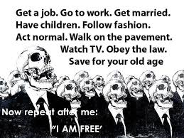

Slide 11
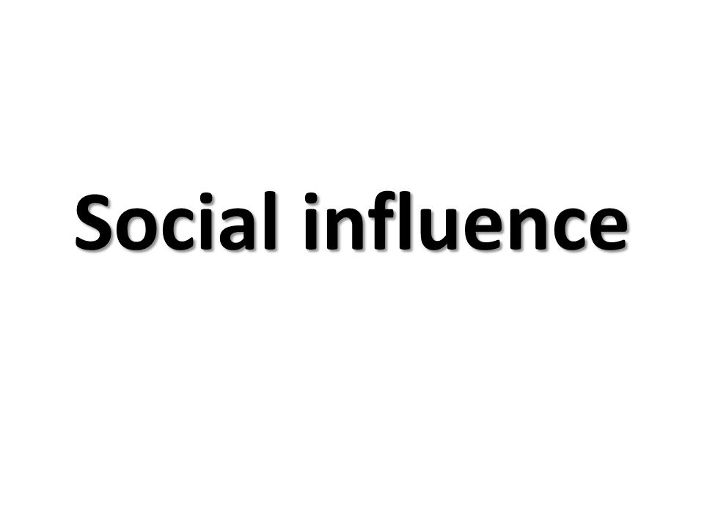

Slide 12
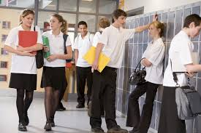
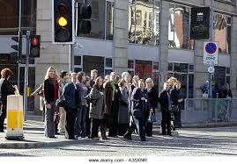
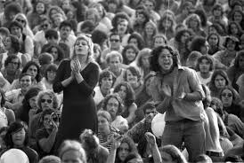
At school
At the traffic lights
At a large crowd
At a pub

Slide 13
CONTENT BASED TASK (CBT) 20 pts
learning through a content based task
R & L & S &W tasks
process
process (task completion): 5 pts
output (task achievement): 15 pts

Slide 14
OUTPUT (15 pts)
WRITTEN:
Answer the questions below by referring to the input tasks that we have covered.

