Slide 1
CONFORMITY in EDUCATION
AGREE
DISAGREE

Slide 2
Schools kill creativity
AGREE
DISAGREE

Slide 3
Schools all too often resemble prisons
AGREE
DISAGREE

Slide 4
Standardized tests do not measure students’ real performance
AGREE
DISAGREE

Slide 5
Success should be measured in terms of academic achievement
AGREE
DISAGREE

Slide 6
Sometimes getting away from school is the best thing that can happen to a great mind
AGREE
DISAGREE

Slide 7
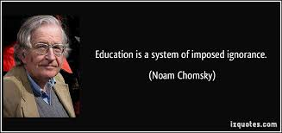
AGREE
DISAGREE

Slide 8
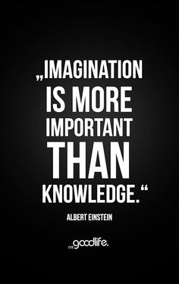
AGREE
DISAGREE

Slide 9
AGREE
DISAGREE

Slide 10
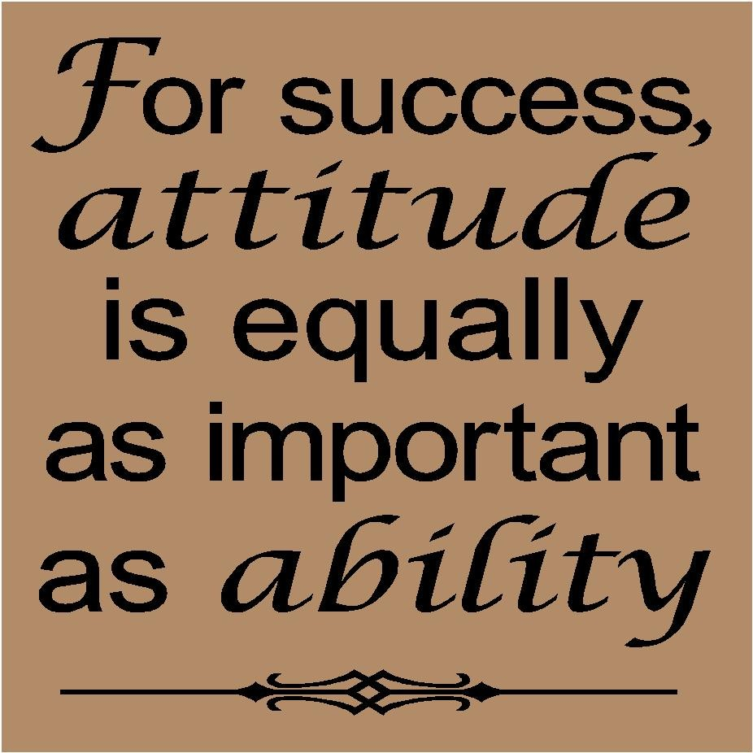
AGREE
DISAGREE

Slide 11
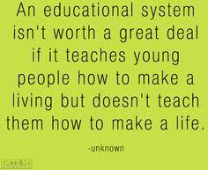
AGREE
DISAGREE

Slide 12
AGREE
DISAGREE

