Slide 1
lecture 10: SSM in detail
SSM was developed over several years, going through a number of major versions
the present version is called the “four activities”
the four activities make up the SSM learning cycle that often progresses simultaneously in all activities after starting with the first one
this was shown in the lecture 9 diagram that we reproduce below:

Slide 3
the four activities are:
finding out about a problem situation, including the social and the political aspects;
building purposeful activity models;
using the models to structure discussion about the situation and its improvement
defining and taking action in the situation to bring about improvement.
We describe each step in detail.

Slide 4
step 1: finding out
tools and techniques useful in this step are:
making rich pictures
analysis one (of the intervention)
analysis two (of social issues)
analysis three (of political issues)

Slide 5
making rich pictures
The complexity of human situations is always one of multiple interacting relationships; a picture is a good way to show relationships
in making a rich picture the aim is to capture, informally, the main entities, structures and viewpoints in the situation, the processes going on, the current recognised issues and any potential ones

Slide 6
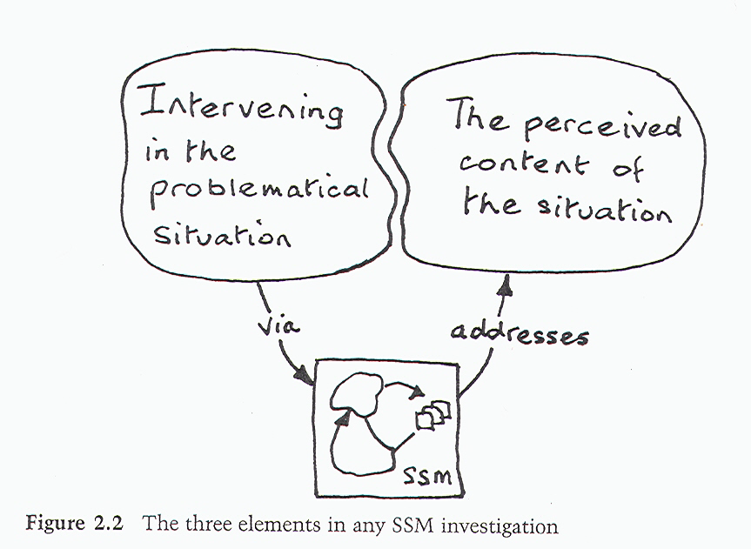
analysis one
in every case of SSM, three elemnts are involved: the methodology, the use of the methodology by a practitioner and the situation - all brought together in a particular relationship:

Slide 7
three key roles are always present:
there is some person (or group of persons) who has caused the intervention to happen, someone without whom there would not be an investigation at all- this is the role 'client'
there is some person (or group of persons) who are conducting the investigation - this is the role 'practitioner'.
most importantly, whoever is in the practitioner role could choose and list, a number of people who can be regarded as being concerned about or affected by the situation and the outcome of the effort to improve it, ­this is the role 'owner of the issue(s) addressed'.

Slide 9
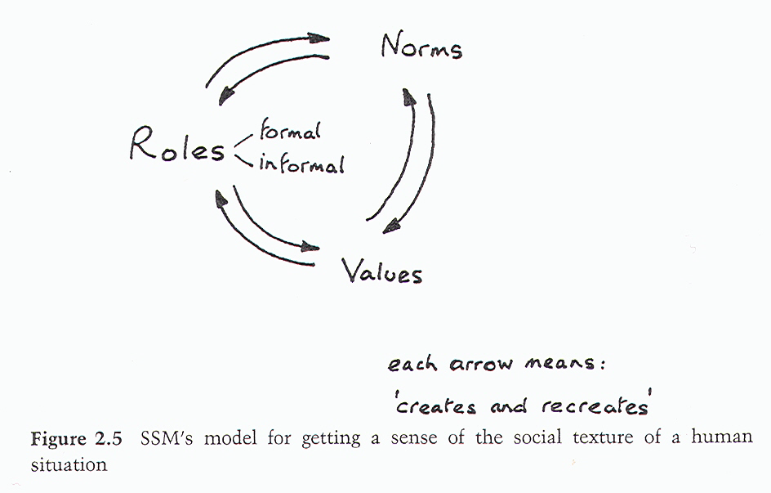
analysis two
analysing the situation as a social system, building on knowledge of the significant roles that people occupy, to investigate the norms and values that are expressed. Roles are taken to be the social positions people occupy, which might be institutional or behavioural. Norms are the expected, or normal, behaviour in this context. Values are the local standards used to judge people's norms. The idea of this analysis is that the analyst should try to understand how people play out their roles.

Slide 10
how to carry out analysis two?
at the start of an intervention open a file marked ‘Analysis Two'.
every time you interact with the situation, like talking to people informally, reading a document, sitting in a meeting etc., ask yourself afterwards whether that taught you anything about the roles, norms and values which are taken seriously here and characterize this particular group
record the finding in the 'Analysis Two' file; carry on doing this throughout the engagement

Slide 12
analysis three
politics is a part of culture not addressed directly in the examination of roles, norms and values of Analysis Two
analysis three determines what is 'culturally feasible'
accommodating different interests is the concern of politics;
pursuit of interests takes place in a power-based structure
analysis three in SSM asks: how is power expressed in this situation?

Slide 14
the question can be tackled through the metaphor of a 'commodity' which embodies power which takes different forms such as:
hierarcical power
personal charisma
committee membership
access to information
intellectual authority etc.
open a file and record in it with a date, any learning gained about power and the processes through which it is exercised
reflect upon it, over the whole course of an investigation

Slide 15
step 2: building purposeful activity models
to build models we first need a statement describing the activity system to be modelled
such descriptions are known in SSM as root definitions (RDs), e.g:
a RD that is too simple:‘a system to paint the garden fence'
a more useful RD: ‘a householder-owned and staffed system to paint the garden fence, by hand­painting, in keeping with the overall decoration scheme of the property in order to enhance the appearance of the property’

Slide 16
model building takes place in five steps:
the PQR formula': do P, by Q, in order to help achieve R, where PQR answer the questions: What? How? and Why?
the model builder has to be able to defend Q as a plausible 'how' for the 'what' defined by P; PQR allows you to write out the RD as a statement which always describes the purposeful activity being modelled as a transformation process, one in which some entity is transformed into a different state
(note that the transformation in SSM is very specific and different from the general concept; it involves the same entity being transformed from one state into another)

