Slide 3
step 3: using models to structure discussion about the situation and its improvement
typical discussions among professionals result in confusion which then provides a cover for personal and private agendas to be advanced
use of purposeful activity models helps to avoid this
structure to the discussion is provided by using the models as a source of questions to ask about the situation
this phase of SSM has usually been referred to as a 'comparison' between situation and models, but this wording is dangerous if it is taken to imply that the discussion focuses on deficiencies in the situation when set against the 'perfect' models
the purposeful activity models simply enable our organized discussion to take place

Slide 4
from the model we can define a set of questions to ask; for example:
‘here is an activity in this model; does it exist in the real situation? who does it? how? when? who else could do it? how else could it be done?' ... etc. or:
‘this activity in the model is dependent upon these other two activities; is it like this in the real situation?'
the questions can be about activities or the dependence of one activity upon another or upon the measures of performance by which purposeful activity is judged
‘what criteria would indicate the degree to which this activity, or the set of operational activities is efficacious, efficient and effective?' this is usually a difficult question to answer in most real-world situations, due to their complexity, but it usefully draws attention to the need for organised processes of monitoring

Slide 5
a given model based upon a declared (pure) worldview will draw attention to other, usually implicit, worldviews which may underlie what is actually going on in the situation; this may serve to define other relevant models worth building
in practice, several ways of conducting the questioning of the situation have emerged:
to have a discussion about improving the situation in the presence of the models
a more formal approach, most commonly used, is to create a chart matrix as in Figure 2.12.

Slide 8
a third way of using models to question reality is to use a model as a basis for writing an account of how some purposeful action would be done according to the model, and comparing this story, or scenario, with a real­world account of something similar actually happening
whichever way the models are used to structure discussion, the aim is the same:
to find a version of the real situation and ways to improve it which different people with different worldviews can nevertheless live with

Slide 10
step 4:defining ‘action to improve‘
a consensus is a rare special case among groups of people, and usually occurs only with respect to issues which are trivial or not contentious
SSM works with the idea of finding an accommodation among a group of people with a common concern
ie. they will have to find a version of the situation which they can all live with
the relations between accommodations, consensus and changes is summarized in Figure 2.14

Slide 12
seeking accommodation is by exploring possible changes and noting reactions to them.
in doing this, it is best to think richly about change in human situations, separating the concept into three parts for analytical purposes, even though any significant change in real situations will usually entail all three elements; these are:
making changes to structures,
changing processes or procedures, and
changing attitudes

Slide 13
the easiest element to change is structure
but new structures usually require both new processes and new attitudes on the part of those carrying out the processes or being affected by them
it is much harder to think out the necessary new processes
and no one can be sure about what to do to change attitudes in a particular direction

Slide 15
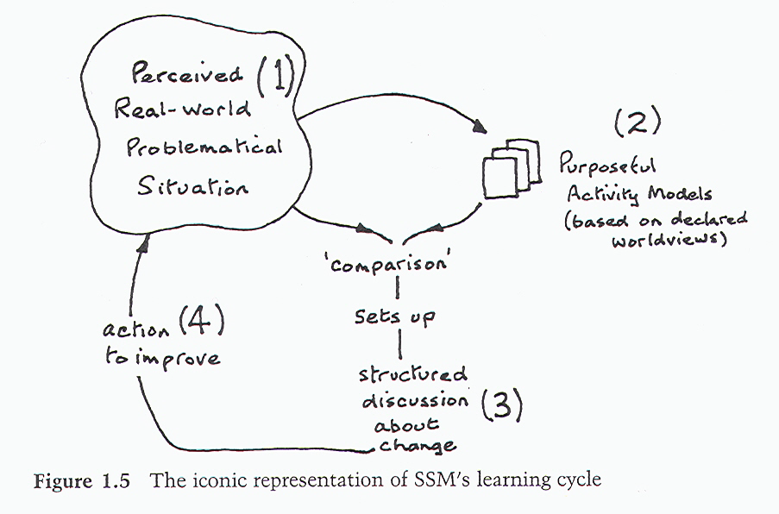
seven principles can be stated that underlines this process
remember Fig 1.5:

Slide 16
the seven principles of SSM
1. the idea of a 'real-world problem' is replaced by the broader concept of 'real-world problematical situation'; ie. a real situation which someone thinks needs attention and action
2. all thinking and talking about problematical situations will be conditioned by the Weltanschauungen of the people doing the thinking and talking; these W’s are the internalized taken-as-given assumptions which cause us to see and interpret the world in a particular way

Slide 17
every problematical situation will contain people trying to act purposefully; this means that models of purposeful activity can be used as devices to explore the qualities and characteristics of any problematical human situation
discussion and debate about such a situation can be structured by using the models in (3) as a source of questions to ask about the situation
acting to improve a real-world situation entails finding, in the course of the discussion/debate in (4), accommodations among different world­views

Slide 18
the inquiry created by principles (1) to (5) is a never-ending process of learning, since taking action to improve the situation will change its characteristics; it becomes a new (less problematical) situation, and the process in (3), (4) and (5) could begin again; learning is never finished
7. explicit organisation of the process which embodies principles (1) to (6) embodies conscious critical reflection about both the situation itself and also about the thinking about it; this reflection,which leads to learning, must take place before, during and after intervening in the situation

Slide 19
note that principle 7 itself defines a fifth action which ensures cycling round the four primary actions, namely critical reflection on the whole process.
this fifth action is at a different level from the other four; it is about the other four, it is the activity which ensures that the lessons learned are captured
Figure 2.16 describes SSM at two levels, as enriched by activity 5

